Slide 1


BO Universe (Information Design Tool)
Prepared by : Manikant Yadav

Slide 2
Agenda
  Navigate the interface
  Create Project and Connections
  Data foundation layer introduction and creation
  Joins creation (DF)
  Derived Tables
  Business Layer Introduction Creation
  Objects Creation(Class, Dimension, Detail, Measure and LOV) in Business layer
  Hide Object and Class
  Publish/Retrieve Universe and connection
  Navigation Path
  Data Security( Universe, Row, Column)
  Join Path Problems(Loop, Chasm, Fan Traps)
Prepared by : Manikant Yadav

Slide 3
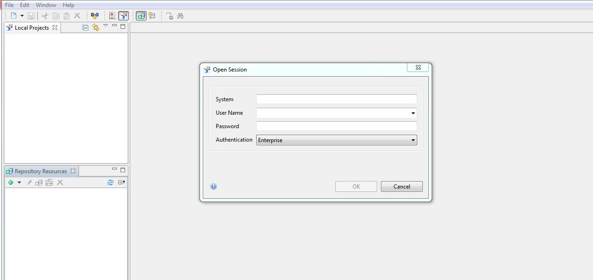
Navigate the interface
Login into IDT -> Go to Repository Resource ->Add session-> Provide System Name and Credential and Click ok (First Time)
Once Session has been created and save . Next time just click on Open session-> Provide credential and login
Prepared by : Manikant Yadav

Slide 4
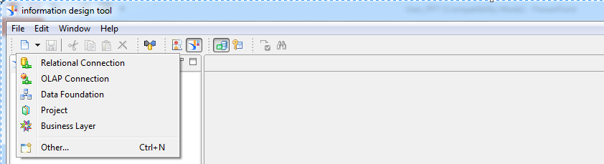
Navigate the interface
Toolbar provide easy access to frequently used features of IDT, along with Navigation views, local projects, Integrity check and Security editor
Prepared by : Manikant Yadav

Slide 5
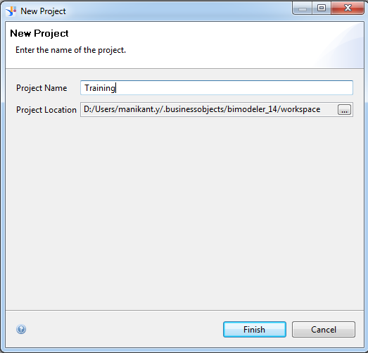
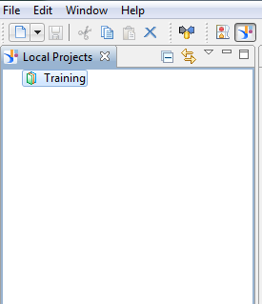
Create Project
  Project Need to be created first before starting with Universe development
  Go to File New ->Project
Prepared by : Manikant Yadav

Slide 6
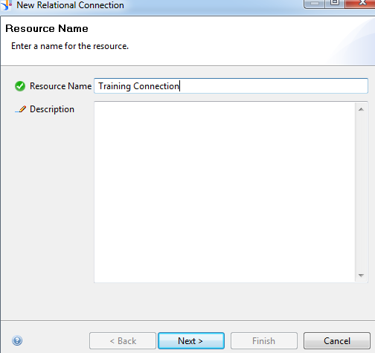
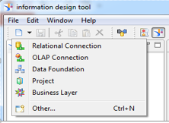
Create Connection
  Connection creation is next step in creating a universe .Connection is stored in local Project as local file . Need to published to repository as secured connection . A single connection can be used by multiple Universes
Provide Connection name -> Click Next
  Go to File -> Select Relational Connection
Prepared by : Manikant Yadav

Slide 7
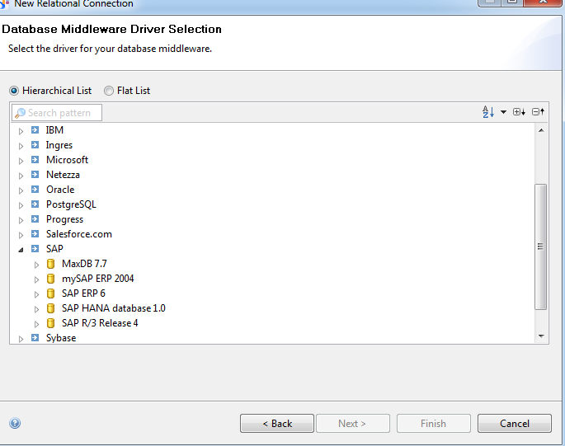
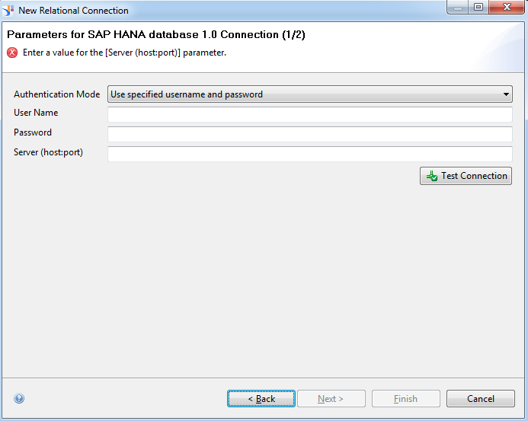
Create Connection
  Provide Credential and Host name -> Click Next Check Test Connection to validate connection
  Select Middleware ->Click Next
Prepared by : Manikant Yadav

Slide 8
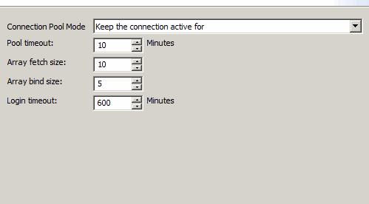
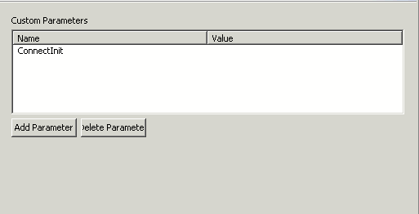
Create Connection
  Provide Connection Parameters-> Click Next
  Click Finish- Connection Created
Prepared by : Manikant Yadav

Slide 9
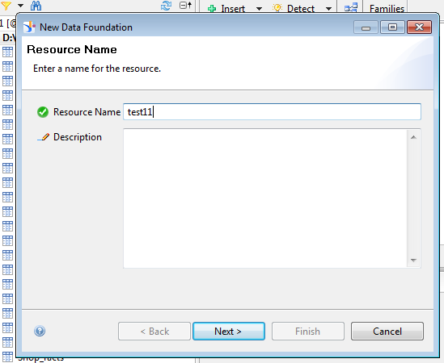
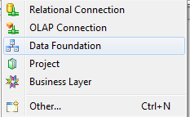
Data Foundation Layer (DF)
Data foundation is the next step for Universe creation. Data foundation contains Tables and Joins.
Note: Data foundation is not required for OLAP Data sources
Create New Data Foundation
Provide DF name and desc click Next
Prepared by : Manikant Yadav

Slide 10
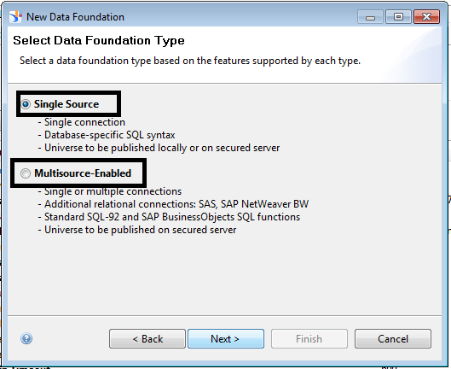
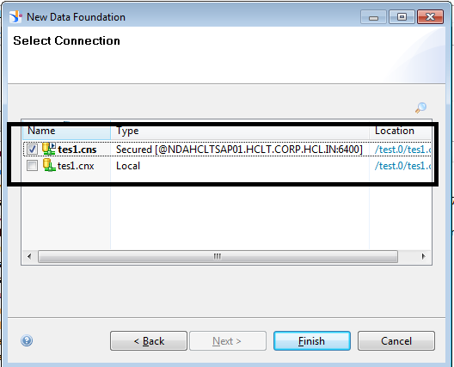
Data Foundation Layer (DF)
  Data Foundation can be created on single connection or multiple connection.
  In below case we would be creating the Data foundation on single source and select the connection to be used as source for Data Foundation and Click Finish
Prepared by : Manikant Yadav

Slide 11
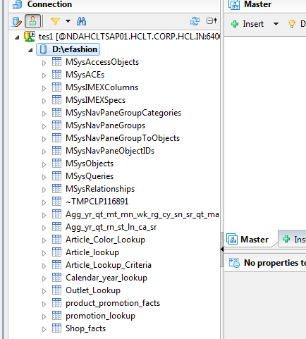
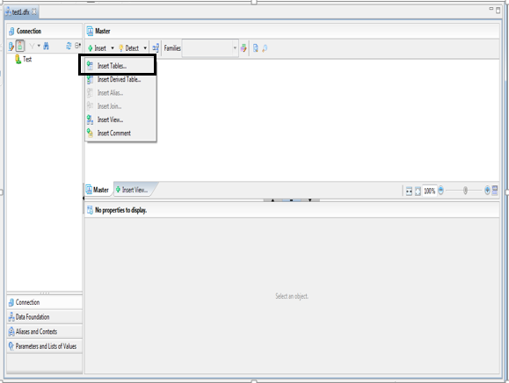
Insert Tables In Data Foundation View
There are 2 ways to insert table in Data Foundation
Expand the connection and select the tables (Double click or drag and drop)
Click Insert tables and Select tables under connection
Prepared by : Manikant Yadav

Slide 12
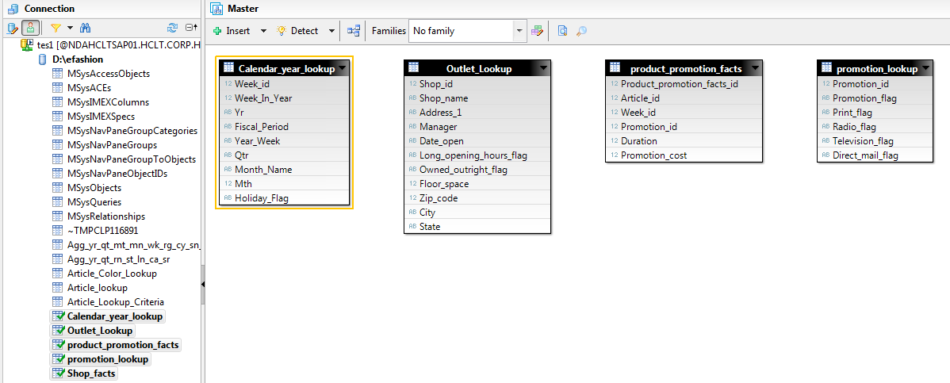
Prepared by : Manikant Yadav

Slide 13
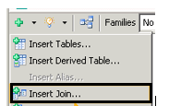
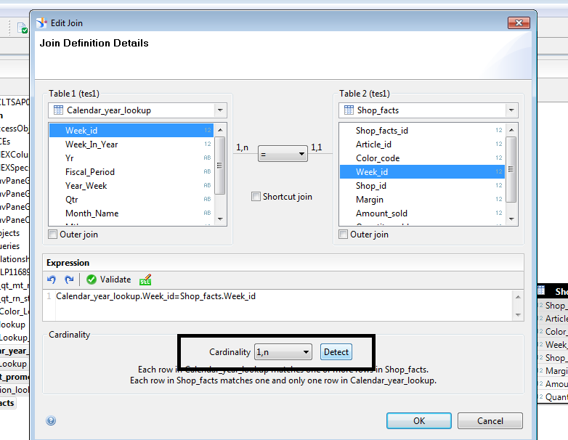
Join Creation
Click on Insert Join
Select the tables under Table 1 and Table 2 and select the columns between which connection need to be defined
Prepared by : Manikant Yadav

Slide 14
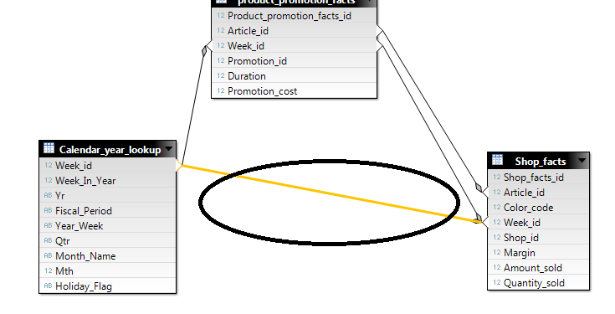
Join Creation
Define the Cardinality and Click Ok
Join is Created between table.
Prepared by : Manikant Yadav

Slide 15
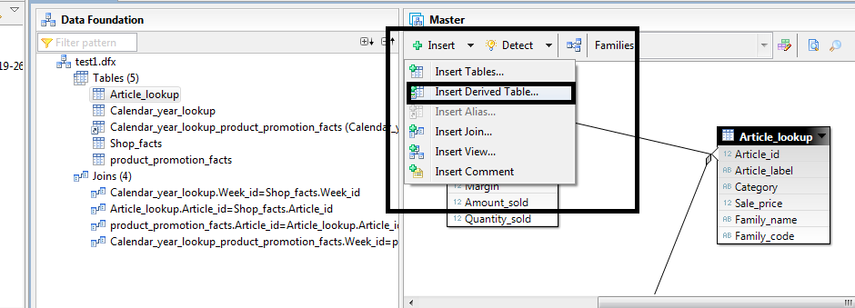
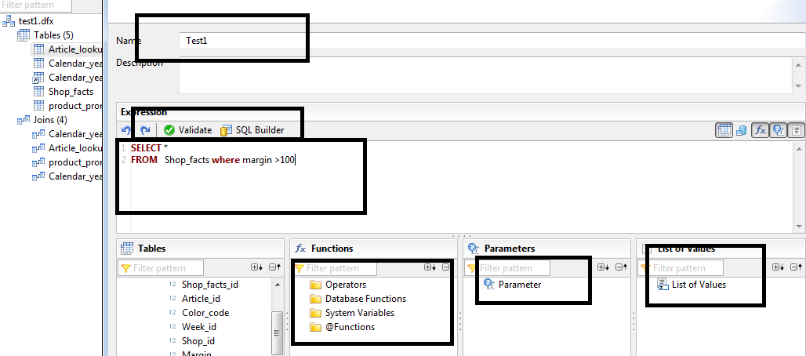
Derived Tables
Derived table are the Logical tables created at Universe level with set of SQL statement and Objects can be created on Derived tables
Provide the Derived table name and SQL Expression
Click Insert derived table
Prepared by : Manikant Yadav

Slide 16
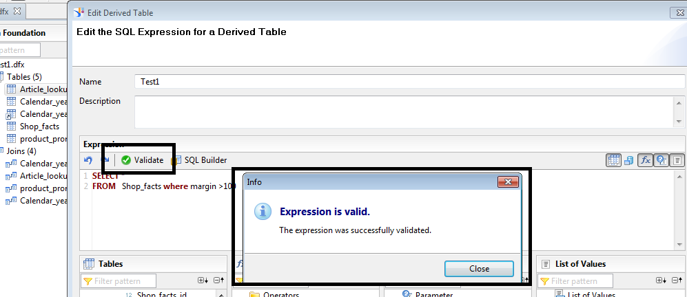
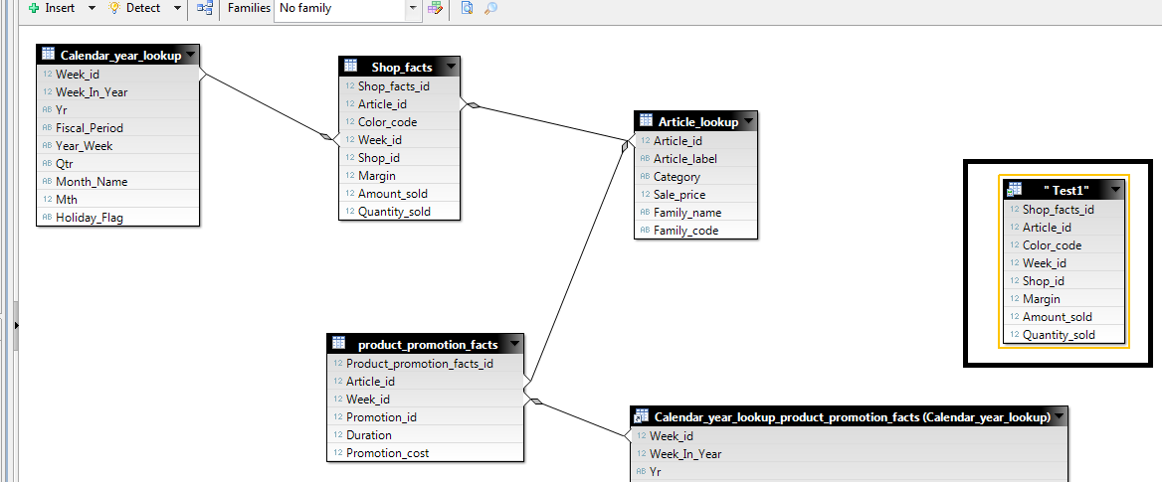
Derived Tables
Validate the SQL expression and Click Ok
Derived table is created and Available
Prepared by : Manikant Yadav

Slide 17
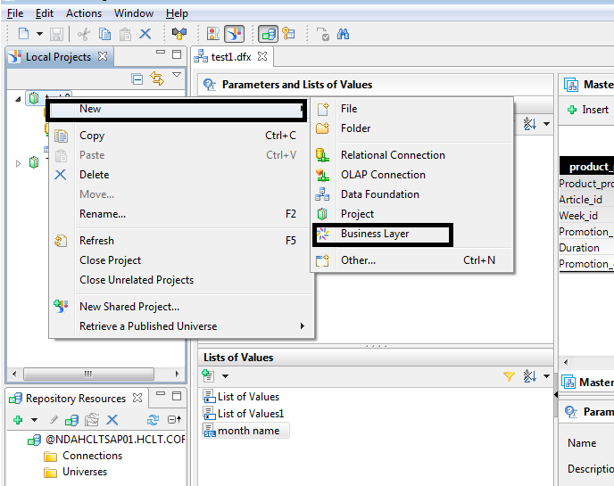
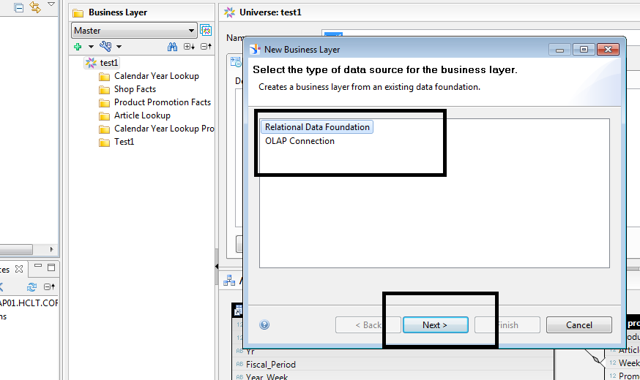
Business Layer(BL)
Business layer creation is the next step after DF creation for relational database based Universe
Business Layer Object are available to user for Reporting purpose
Select New -> Click Business Layer
Select Data source for Business Layer
Prepared by : Manikant Yadav

Slide 18
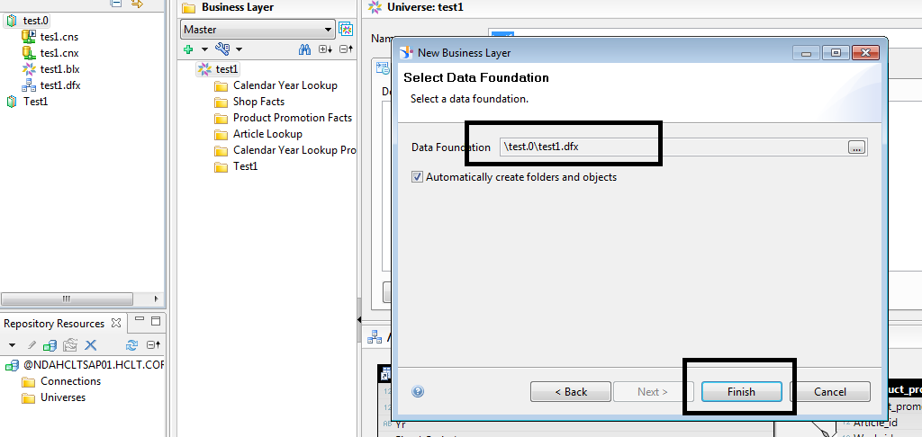
Business Layer(BL)
After providing the Business layer name ,Select the data foundation on which Business layer is based upon and Click Finish
Note:If Automatically created folder and object is selected, Then Class and objects will be created automatically in business layer
Prepared by : Manikant Yadav

Slide 19
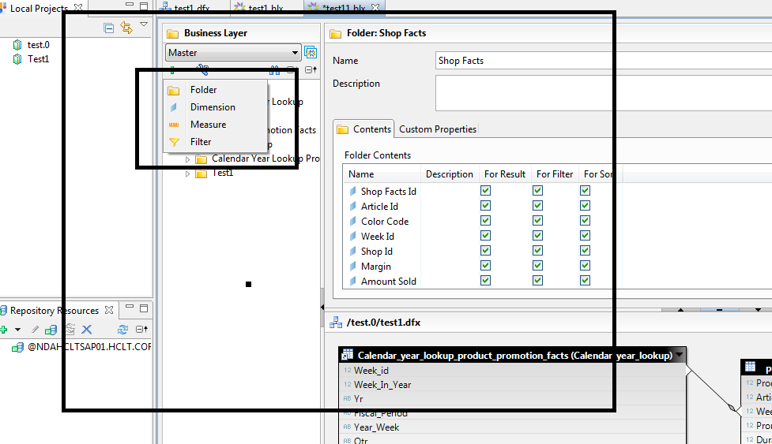
Object Creation in Business Layer
Before creation of any Objects(Dimension, Measure or Filter Object) .
First Create the folder , i.e. Click + under Business layer Select folder ,Provide Folder name and click Ok
Prepared by : Manikant Yadav

Slide 20
Object Creation in Business Layer(Dimension)
For creation of Dimension object ,Select the folder under which object would be created then Click + under Business layer Select Dimension Object
Prepared by : Manikant Yadav

Slide 21
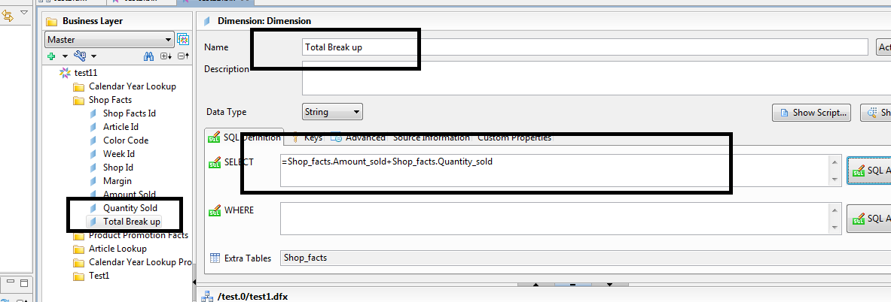
Object Creation in Business Layer(Dimension)
Provide Dimension Object name and Object Qualification details such as Type, Field mapping/ SQL(Under select or where class) and other details(LOV,data format etc under Advance )
Prepared by : Manikant Yadav

Slide 22
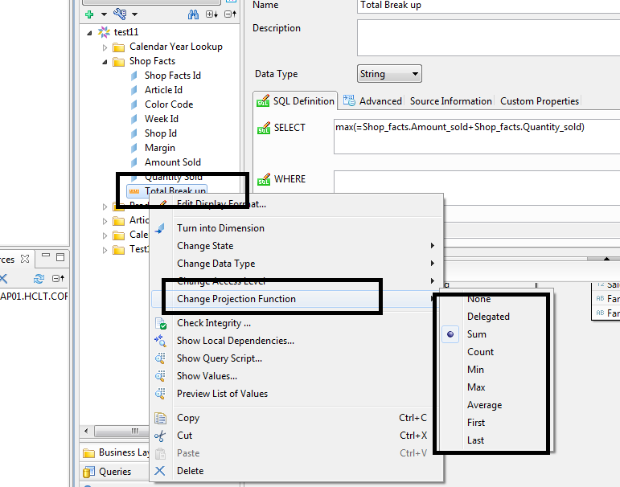
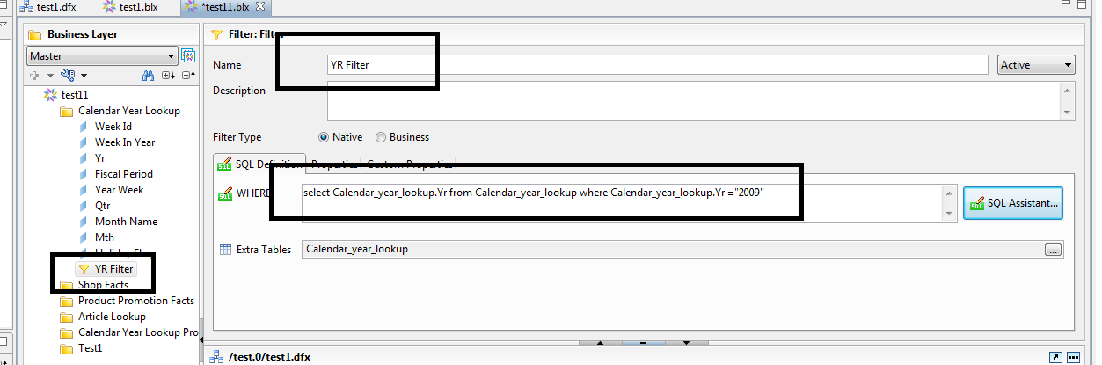
Object Creation in Business Layer(Measure, Filters and Detail)
Similar to Dimension object creation , Measure, detail and Filter object is created
Note:
Measure Object shall be associated with Aggregate function
Filter objects will contain the where clause
Detail Object will always associated with dimension Object
Prepared by : Manikant Yadav

Slide 23
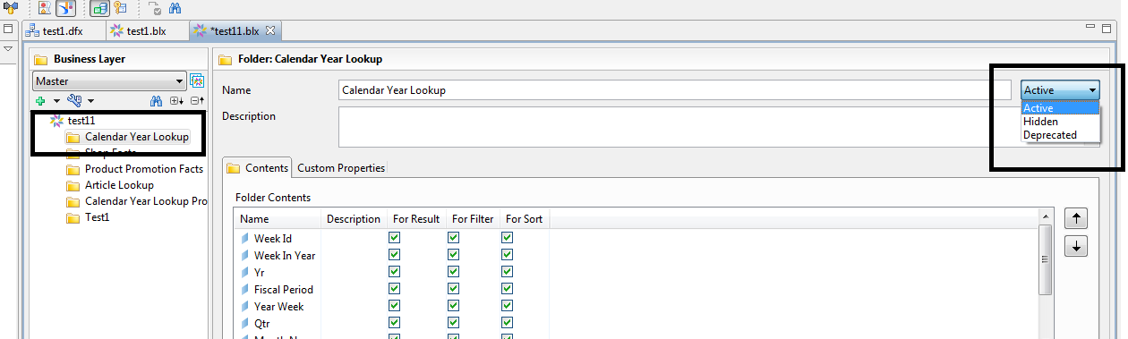
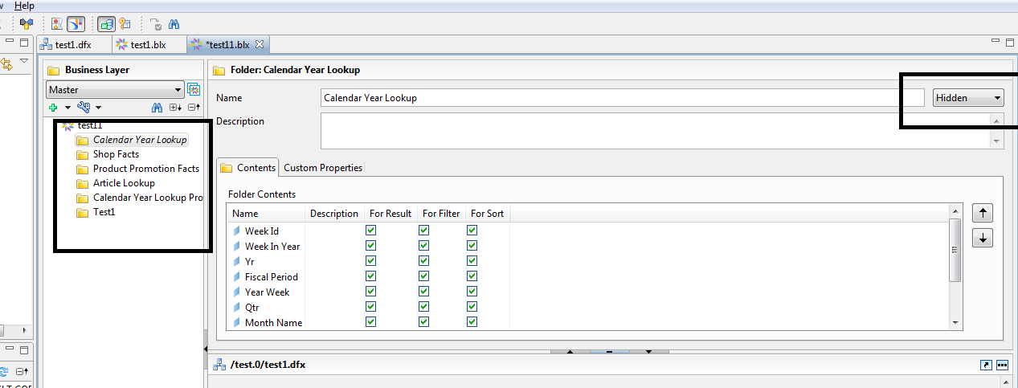
Hide Class and Underlying Object in Class
In order to Hide the class .Perform following steps
Select the class Which need to be hidden
Change the state of class from Active to Hidden
Now Class and underlying all the objects in class will be hidden and unavailable to users for reporting
Note: Changes need to be saved and Universe need to be published to reflect changes in repository
Prepared by : Manikant Yadav

Slide 24
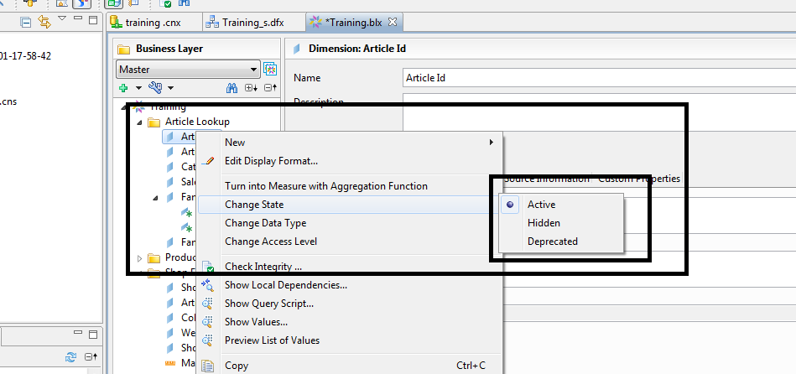
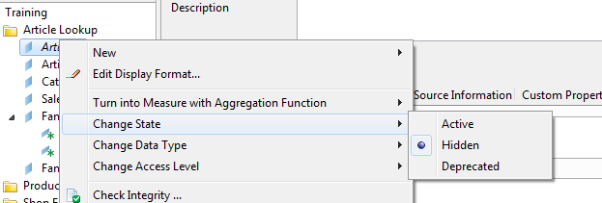
Hide Objects
We can hide individual Objects by following steps
Right Click on Object and select State as Hidden
Prepared by : Manikant Yadav

Slide 25
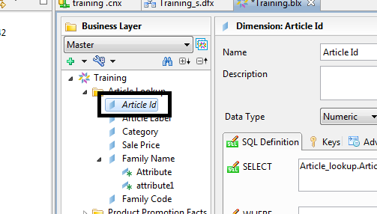
Hide Objects
Prepared by : Manikant Yadav

Slide 26
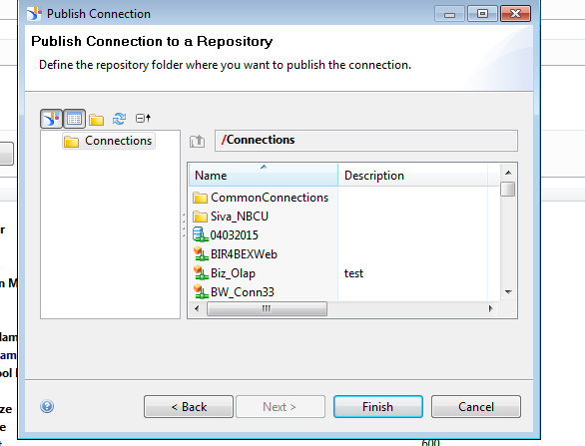
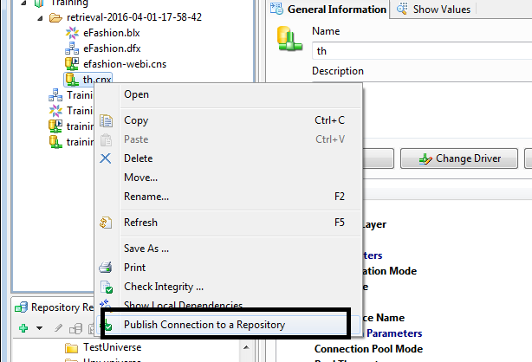
Publish Connection to repository
In order to publish the connection to Repository .Following steps are required
Right click on local connection which need to be published
Select Publish Connection to a Repository.
Select the folder in Repository in which connection need to be published.
Click Finish
Prepared by : Manikant Yadav

Slide 27
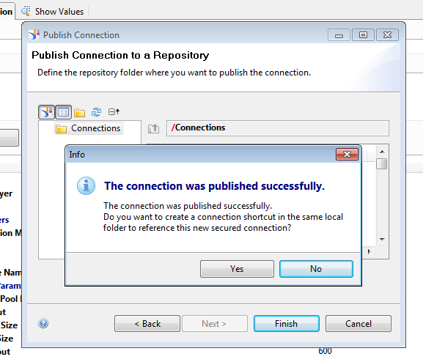
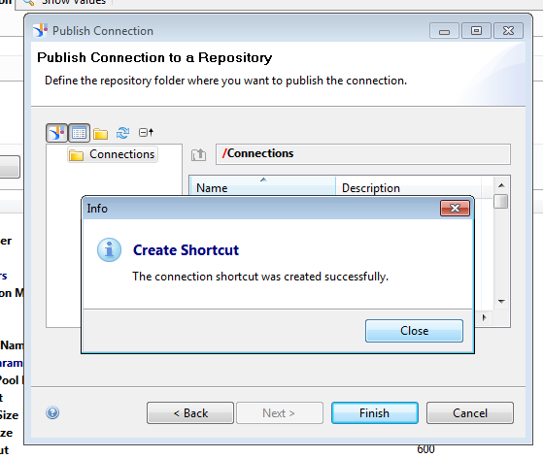
Publish Connection to repository
Connection is successfully published
We can created as Shortcut to a connection under Local folder to utilize the published connection
Prepared by : Manikant Yadav

Slide 28
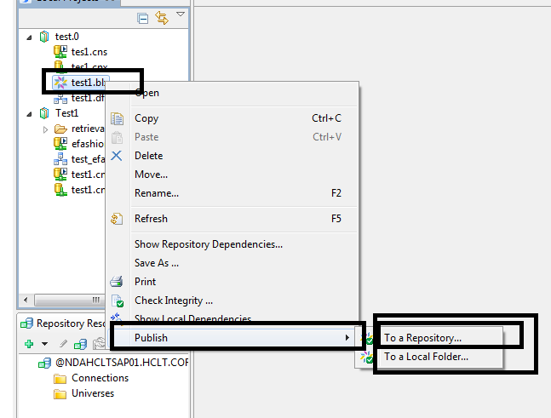
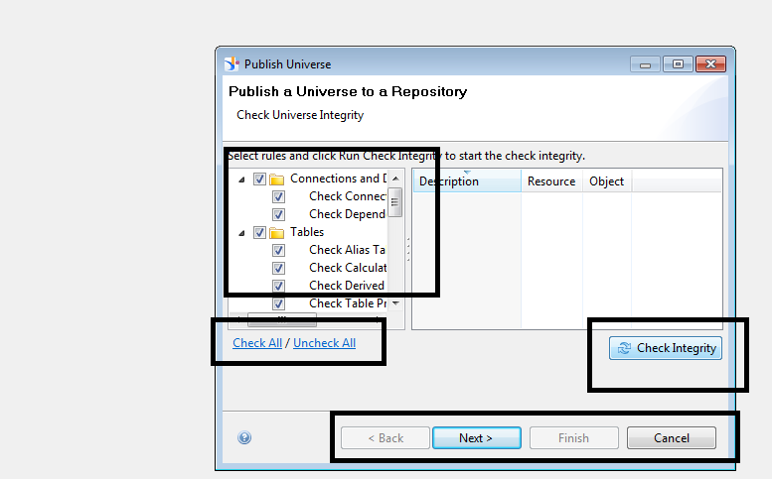
Publish Universe to repository
In order to publish the universe to Repository Following steps are required
Right click on Business Layer created under Project .Select Publish-> To a repository
Check Integrity of Universe . Click Next
Select the folder in Repository in which Universe need to be published
Click Finish
Prepared by : Manikant Yadav

Slide 29
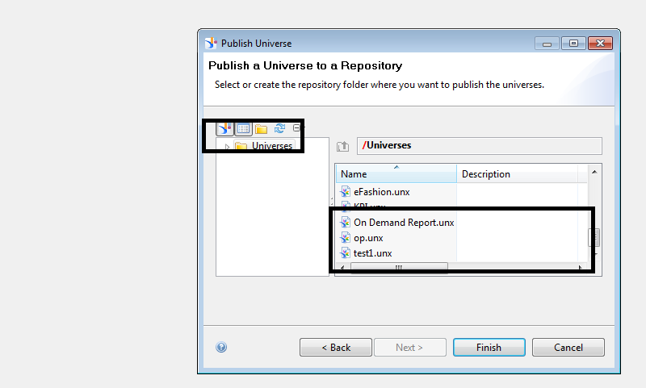
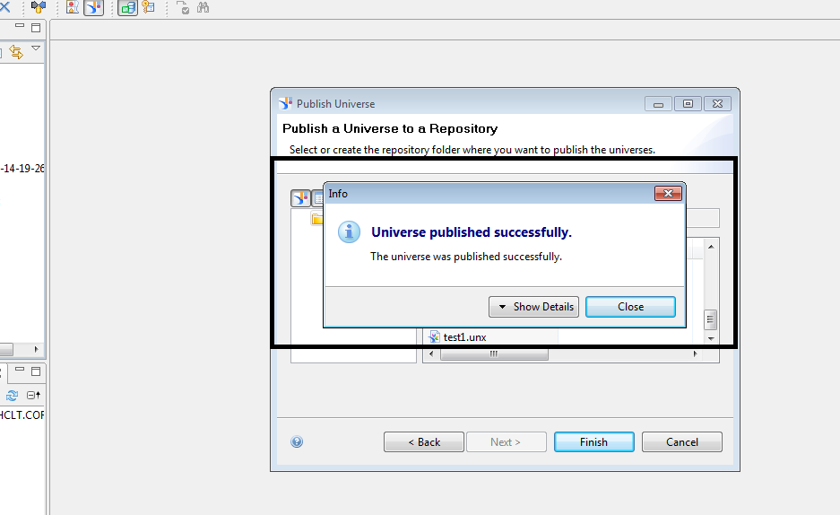
Publish Universe to repository
Note: Universe can only be published to repository with Secured connection
Once Universe is published to repository ,Other user can access the Universe for reporting purpose
Prepared by : Manikant Yadav

Slide 30
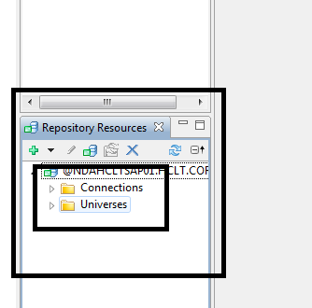
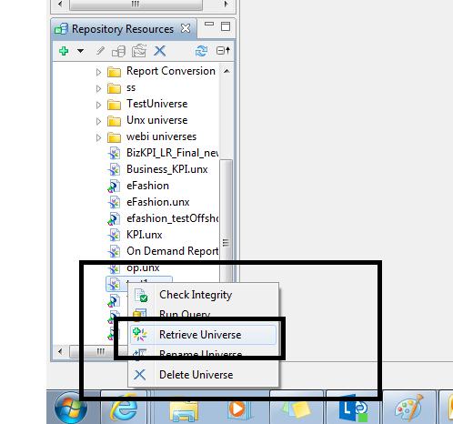
Retrieve the Universe from repository
In order to retrieve the Universe from repository. You should be connected with repository
Expand The Universe Folder and Select the Universe
Right click on selected Universe and Click retrieve Universe
Prepared by : Manikant Yadav

Slide 31
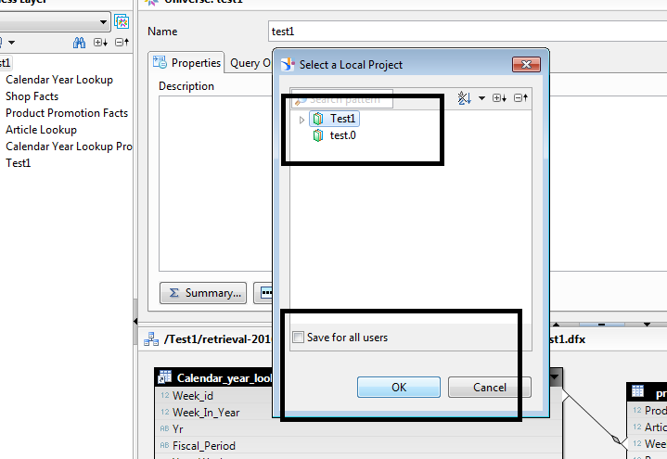
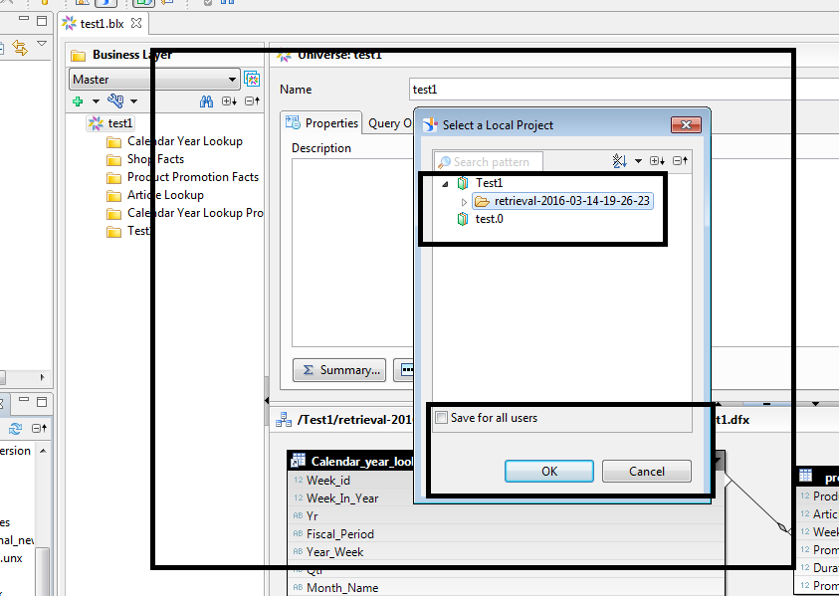
Retrieve the Universe from repository
Select the local Project Under which Universe need to be retrieved
Click Ok. Local copy of Universe would be available under folder of Local project (selected while retrieving universe)
Prepared by : Manikant Yadav

Slide 32
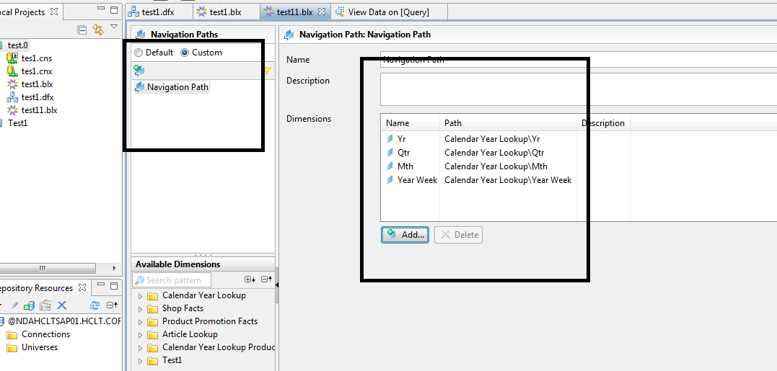
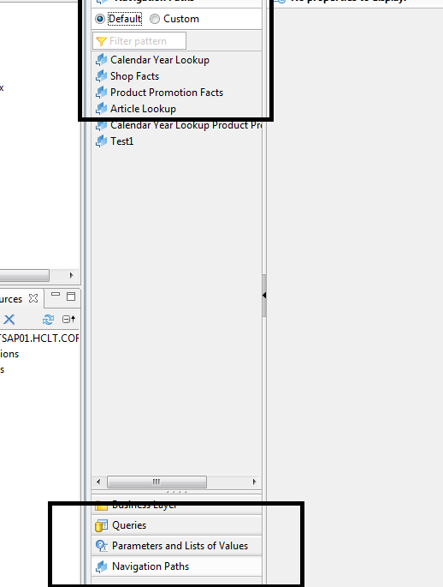
Navigation Path
Navigation Path define the drill path used for reporting purpose can only be defined for Dimension Objects.
Go to Navigation Path . Select Custom. Click add Navigation .
Provide the navigation path name and add dimension object with Object at High level granularity to low level and save business layer
Prepared by : Manikant Yadav

Slide 33


Data Security
Security profile determines what objects, data ,connection user sees when connecting to Universe
There are 2 types of Profile : Data and Business security profile
Data security profile shall be created as below
Go to security editor ,Right click on Universe and select Insert Data Security profile
Prepared by : Manikant Yadav

Slide 34


Row Level Data Security
At rows tab Select Insert and select the table on which restriction need to be applied
Prepared by : Manikant Yadav

Slide 35


Row Level Data Security
Define the restriction expression and click Ok
Prepared by : Manikant Yadav

Slide 36

Table Level Data Security
At Table tab Select Insert and select the table which table replacement security need to be applied
Provide original and replacement table name and click Ok
Prepared by : Manikant Yadav

Slide 37
Join Path Problems
There are 3 type of Join path problems : Loop, Chasm Trap and Fan Trap
If they are not resolved at Universe level, will give incorrect result at reports
These problems can be resolved via a Context or Aliases
Aliases: It represent the alias table created at universe level based upon original table which serves as different purpose/meaning and used for resolving loop For. example Region Table can represent Resort Region or Customer Region
Context: It represent defined path which need to be used when more than one path is possible
Resolving Join Path:
Loop: Context or Alias
Chasm Trap: Context
Fan Trap : Using Aliases and Context
Prepared by : Manikant Yadav

Slide 38

Loop
Prepared by : Manikant Yadav

Slide 39

Resolving Loop
Prepared by : Manikant Yadav

Slide 40

Chasm Trap
Prepared by : Manikant Yadav

Slide 41


Resolving Chasm Trap
1st Context
2nd Context
Prepared by : Manikant Yadav

Slide 42

Fan Trap
Prepared by : Manikant Yadav

Slide 43
  The End
Prepared by : Manikant Yadav

